Slide 1
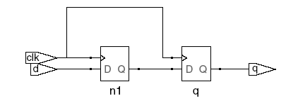

Blocking vs. Nonblocking Assignment
<= is nonblocking assignment
Occurs simultaneously with others
= is blocking assignment
Occurs in order it appears in file
// Good synchronizer using
// nonblocking assignments
module syncgood(input logic clk,
input logic d,
output logic q);
logic n1;
always_ff @(posedge clk)
begin
n1 <= d; // nonblocking
q <= n1; // nonblocking
end
endmodule
// Bad synchronizer using
// blocking assignments
module syncbad(input logic clk,
input logic d,
output logic q);
logic n1;
always_ff @(posedge clk)
begin
n1 = d; // blocking
q = n1; // blocking
end
endmodule

Slide 2
Rules for Signal Assignment
Synchronous sequential logic: use always_ff @(posedge clk)and nonblocking assignments (<=)
always_ff @ (posedge clk)
q <= d; // nonblocking
Simple combinational logic: use continuous assignments (assign…)
assign y = a & b;
More complicated sequential logic: use blocking assignments (=) only for intermediate results
More complicated combinational logic: use always_comb and blocking assignments (=)
Assign a signal in only one always statement or continuous assignment statement (if you are not using ‘Z’ values).

Slide 3
General Rules for Combinational Logic
If generic always is used, sensitivity list MUST include all signals used in the always.
Blocking assignments can create latches. Avoid write after read with blocking assignments
all outputs should have default values or must be assigned for every input combination. If not, a latch will be generated to hold the current value.
The actual non-blocking assignment is the last one evaluated

Slide 4
Finite State Machines (FSMs)
Three blocks:
next state logic
state register
output logic
Notes:
Fine lezione 11

Slide 5
FSM Example: Divide by 3
The double circle indicates the reset state

Slide 6
FSM in SystemVerilog
module divideby3FSM (input logic clk,
input logic reset,
output logic q);
typedef enum logic [1:0] {S0, S1, S2} statetype;
statetype [1:0] state, nextstate;
// state register
always_ff @ (posedge clk, posedge reset)
if (reset) state <= S0;
else state <= nextstate;
// next state logic
always_comb
case (state)
S0: nextstate = S1;
S1: nextstate = S2;
S2: nextstate = S0;
default: nextstate = S0;
endcase
// output logic
assign q = (state == S0);
endmodule

Slide 7
Parameterized Modules
2:1 mux:
module mux2
#(parameter width = 8) // name and default value
(input logic [width-1:0] d0, d1,
input logic s,
output logic [width-1:0] y);
assign y = s ? d1 : d0;
endmodule
Instance with 8-bit bus width (uses default):
mux2 myMux(d0, d1, s, out);
Instance with 12-bit bus width:
mux2 #(12) lowmux(d0, d1, s, out);

Slide 8
Testbenches
HDL that tests another module: device under test (dut)
Not synthesizeable
Types:
Simple
Self-checking
Self-checking with testvectors

Slide 9
Testbench Example
Write SystemVerilog code to implement the following function in hardware:
y = bc + ab
Name the module sillyfunction

Slide 10
Testbench Example
Write SystemVerilog code to implement the following function in hardware:
y = bc + ab
module sillyfunction(input logic a, b, c,
output logic y);
assign y = ~b & ~c | a & ~b;
endmodule

Slide 11
Simple Testbench
module testbench1();
logic a, b, c;
logic y;
// instantiate device under test
sillyfunction dut(a, b, c, y);
// apply inputs one at a time
initial begin
a = 0; b = 0; c = 0; #10;
c = 1; #10;
b = 1; c = 0; #10;
c = 1; #10;
a = 1; b = 0; c = 0; #10;
c = 1; #10;
b = 1; c = 0; #10;
c = 1; #10;
end
endmodule

Slide 12
Self-checking Testbench
module testbench2();
logic a, b, c;
logic y;
sillyfunction dut(a, b, c, y); // instantiate dut
initial begin // apply inputs, check results one at a time
a = 0; b = 0; c = 0; #10;
if (y !== 1) $display("000 failed.");
c = 1; #10;
if (y !== 0) $display("001 failed.");
b = 1; c = 0; #10;
if (y !== 0) $display("010 failed.");
c = 1; #10;
if (y !== 0) $display("011 failed.");
a = 1; b = 0; c = 0; #10;
if (y !== 1) $display("100 failed.");
c = 1; #10;
if (y !== 1) $display("101 failed.");
b = 1; c = 0; #10;
if (y !== 0) $display("110 failed.");
c = 1; #10;
if (y !== 0) $display("111 failed.");
end
endmodule

Slide 13
Testbench with Testvectors
Testvector file: inputs and expected outputs
Testbench:
Generate clock for assigning inputs, reading outputs
Read testvectors file into array
Assign inputs, expected outputs
Compare outputs with expected outputs and report errors

Slide 14
Testbench with Testvectors
Testbench clock:
assign inputs (on rising edge)
compare outputs with expected outputs (on falling edge).
Testbench clock also used as clock for synchronous sequential circuits

Slide 15
Testvectors File
File: example.tv
contains vectors of abc_yexpected
000_1
001_0
010_0
011_0
100_1
101_1
110_0
111_0

Slide 16
1. Generate Clock
module testbench3();
logic clk, reset;
logic a, b, c, yexpected;
logic y;
logic [31:0] vectornum, errors; // bookkeeping variables
logic [3:0] testvectors[10000:0]; // array of testvectors
// instantiate device under test
sillyfunction dut(a, b, c, y);
// generate clock
always // no sensitivity list, so it always executes
begin
clk = 1; #5; clk = 0; #5;
end

Slide 17
2. Read Testvectors into Array
// at start of test, load vectors and pulse reset
initial
begin
$readmemb("example.tv", testvectors);
vectornum = 0; errors = 0;
reset = 1; #27; reset = 0;
end
// Note: $readmemh reads testvector files written in
// hexadecimal

Slide 18
3. Assign Inputs & Expected Outputs
// apply test vectors on rising edge of clk
always @(posedge clk)
begin
#1; {a, b, c, yexpected} = testvectors[vectornum];
end

Slide 19
4. Compare with Expected Outputs
// check results on falling edge of clk
always @(negedge clk)
if (~reset) begin // skip during reset
if (y !== yexpected) begin
$display("Error: inputs = %b", {a, b, c});
$display(" outputs = %b (%b expected)",y,yexpected);
errors = errors + 1;
end
// Note: to print in hexadecimal, use %h. For example,
// $display(“Error: inputs = %h”, {a, b, c});

Slide 20
4. Compare with Expected Outputs
// increment array index and read next testvector
vectornum = vectornum + 1;
if (testvectors[vectornum] === 4'bx) begin
$display("%d tests completed with %d errors",
vectornum, errors);
$finish;
end
end
endmodule
// === and !== can compare values that are 1, 0, x, or z.

Slide 21
ADDER
module adder #(parameter N = 8)
(input logic [N–1:0] a, b,
input logic cin,
output logic [N–1:0] s,
output logic cout);
assign {cout, s} = a + b + cin;
endmodule

Slide 22
COMPARATORS
module comparator #(parameter N = 8)
(input logic [N–1:0] a, b,
output logic eq, neq, lt, lte, gt, gte);
assign eq = (a == b);
assign neq = (a != b);
assign lt = (a < b);
assign lte = (a <= b);
assign gt = (a > b);
assign gte = (a >= b);
endmodule

Slide 23
SHIFT REGISTER WITH PARALLEL LOAD
module shiftreg #(parameter N = 8)
(input logic clk,
input logic reset, load,
input logic sin,
input logic [N–1:0] d,
output logic [N–1:0] q,
output logic sout);
always_ff @(posedge clk, posedge reset)
if (reset) q <= 0;
else if (load) q <= d;
else q <= {q[N–2:0], sin};
assign sout = q[N–1];
endmodule

Slide 24
RAM
module ram #(parameter N = 6, M = 32)
(input logic clk,
input logic we,
input logic [N–1:0] adr,
input logic [M–1:0] din,
output logic [M–1:0] dout);
logic [M–1:0] mem [2**N–1:0];
always_ff @(posedge clk)
if (we) mem [adr] <= din;
assign dout = mem[adr];
endmodule

Slide 25
ROM
module rom(input logic [1:0] adr,
output logic [2:0] dout):
always_comb
case(adr)
2'b00: dout = 3'b011;
2'b01: dout = 3'b110;
2'b10: dout = 3'b100;
2'b11: dout = 3'b010;
endcase
endmodule

Slide 26
COUNTER
module counter #(parameter N = 8)
(input logic clk,
input logic reset,
output logic [N–1:0] q);
always_ff @(posedge clk, posedge reset)
if (reset) q <= 0;
else q <= q + 1;
endmodule

Slide 27
Free tools
Simulatore (icarus verilog):
sudo apt-get iverilog
Sintesi (yosys):
sudo apt-get yosys
Visualizzatore schematici
sudo npm install -g netlistsvg
Visualizzatore waveforms
sudo apt-get gtkwave

Slide 28
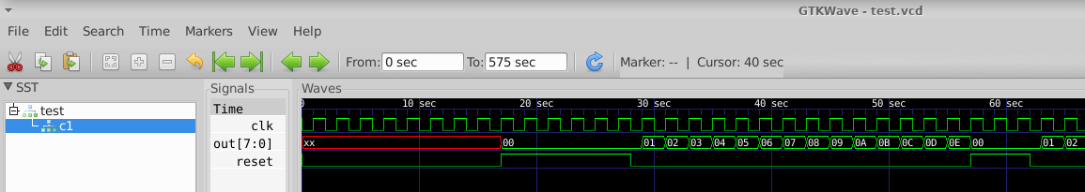
Esempio contatore: simulazione
$ iverilog -o tb counter_tb.v counter.v
$ vvp tb
$ gtkwave test.vcd

Slide 29
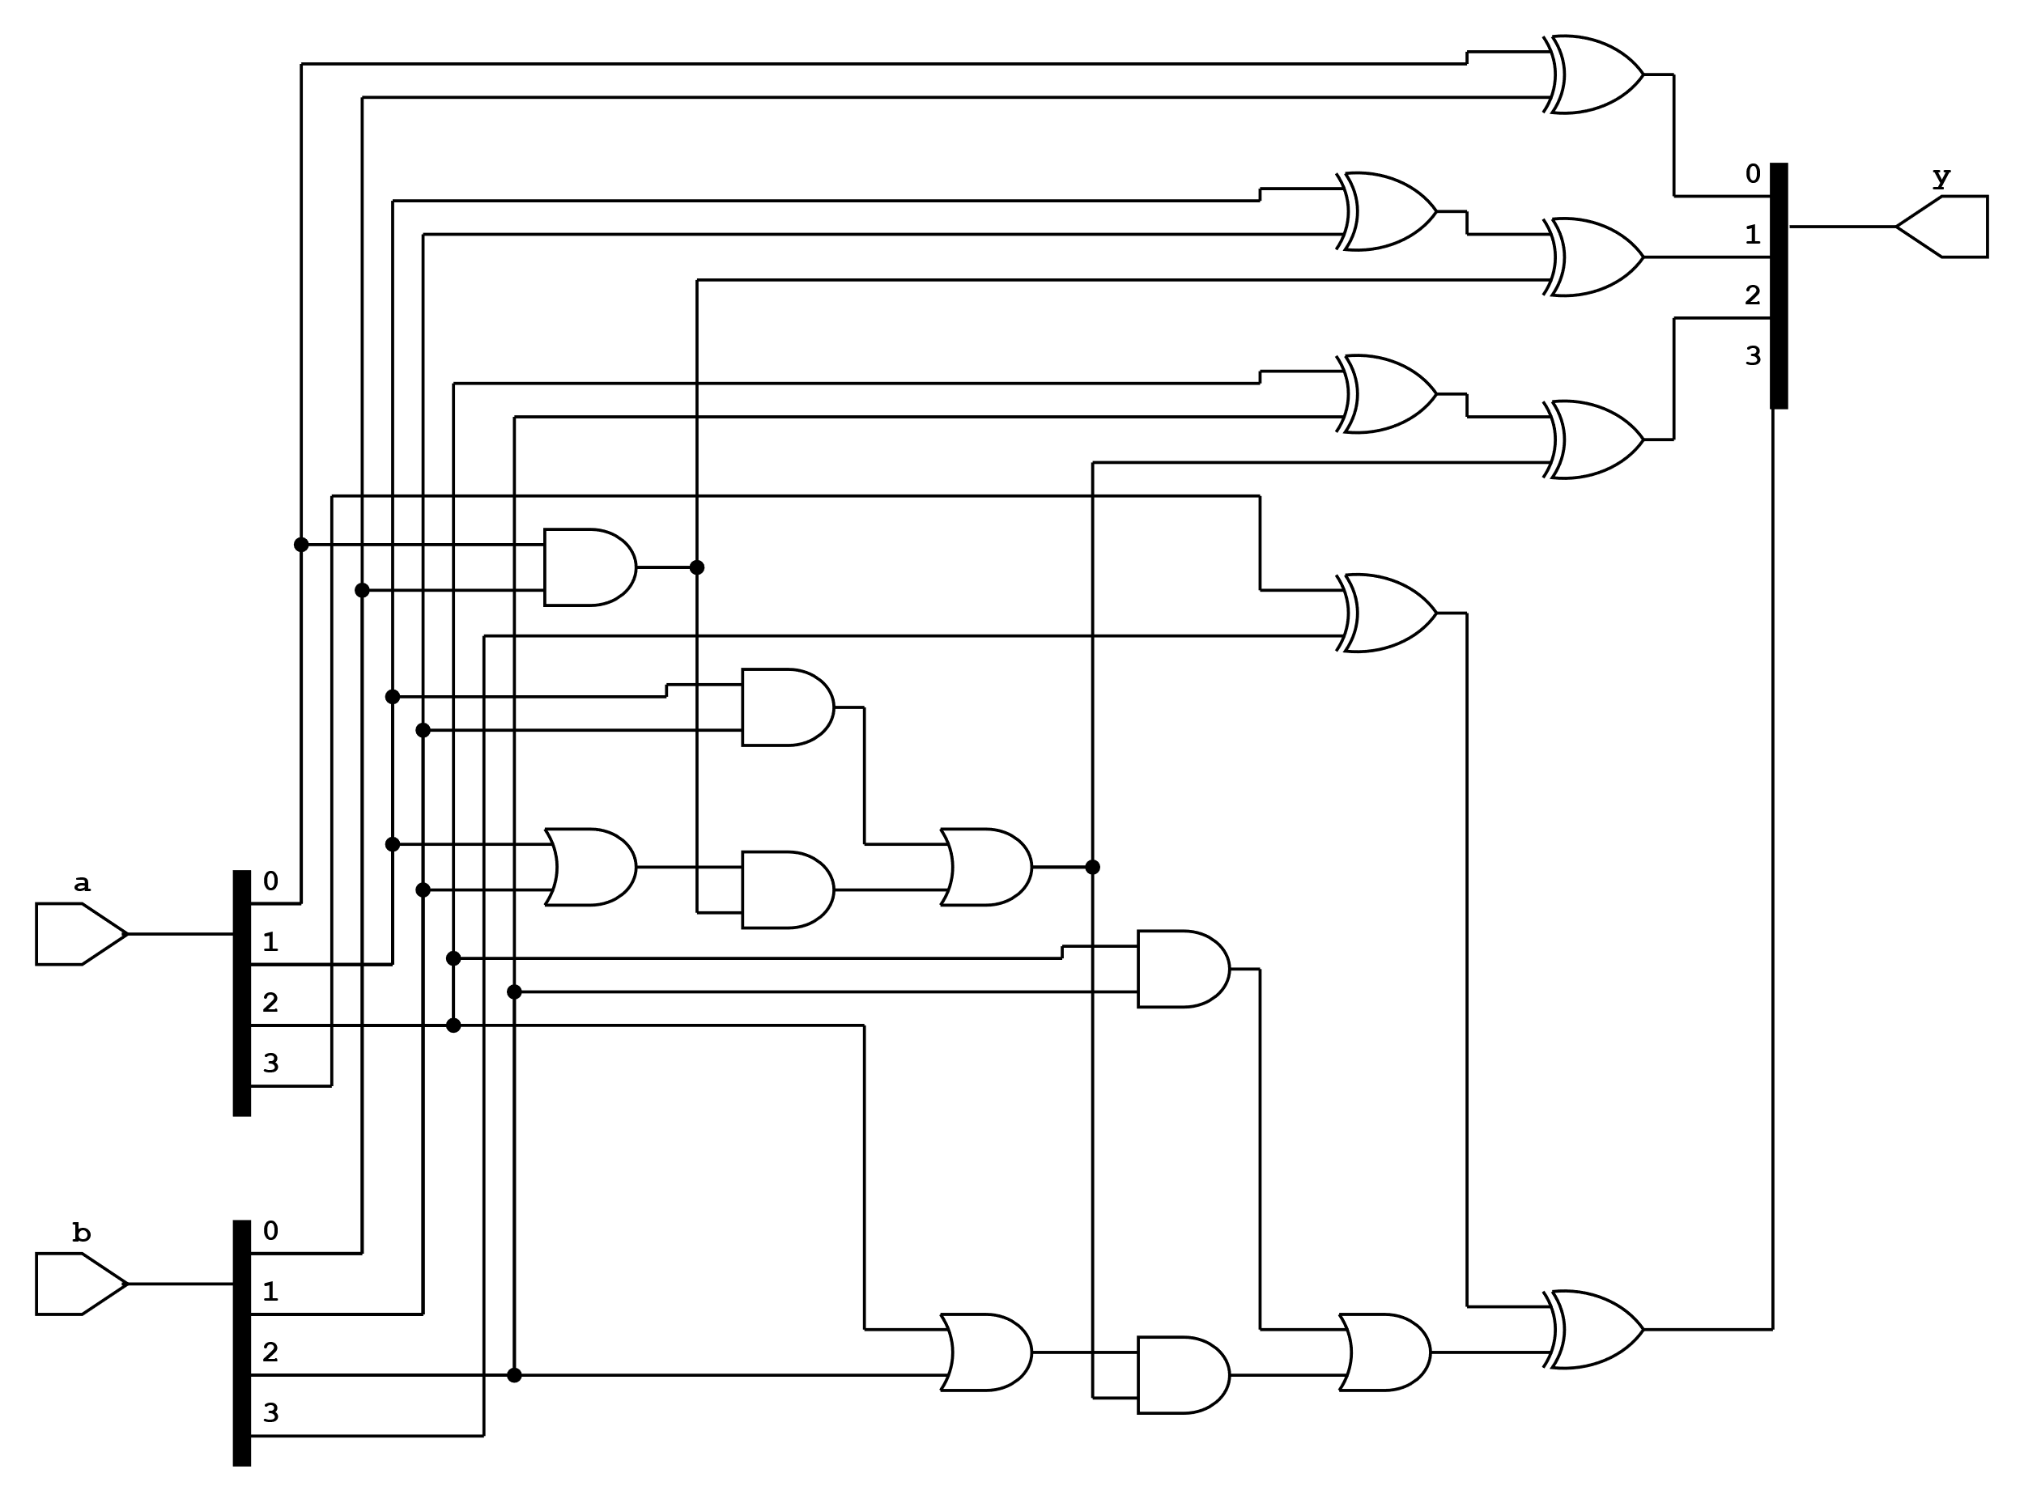
Esempio sommatore: sintesi
$ yosys synth.ys
$ netlistsvg carryadd.js -o carryadd.svg
$ ristretto carryadd.svg

Slide 30
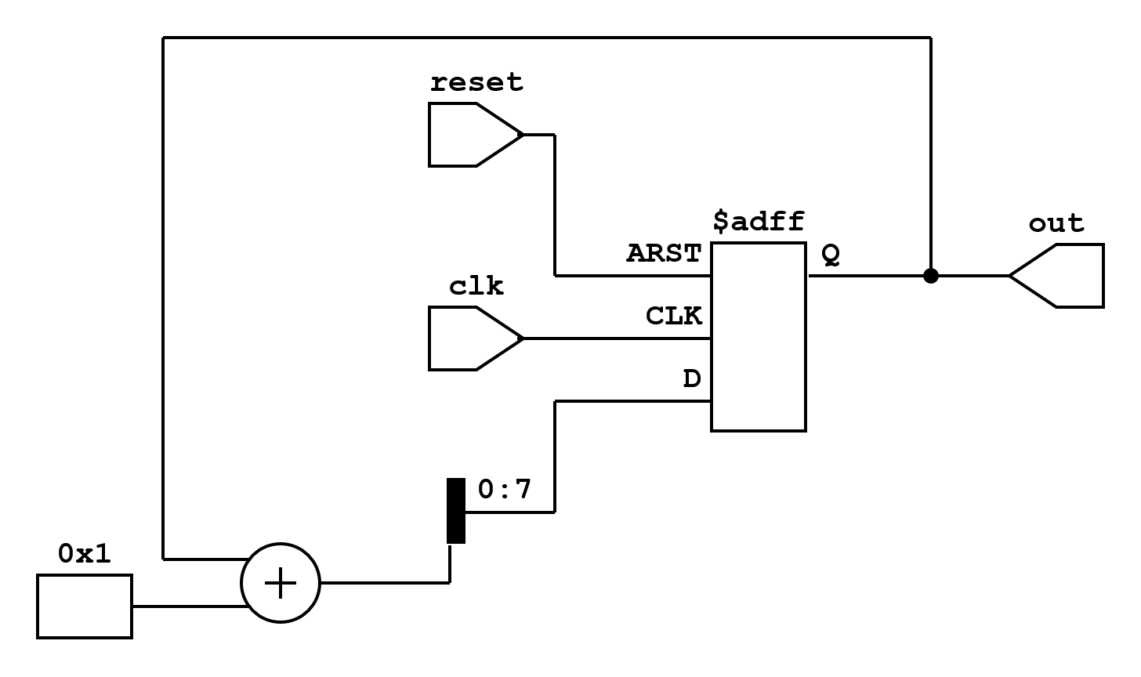
Esempio contatore: sintesi (RTL)
$ yosys synth_count.ys
$ netlistsvg counter_rtl.js -o counter_rtl.svg
$ ristretto counter_rtl.svg

Slide 31
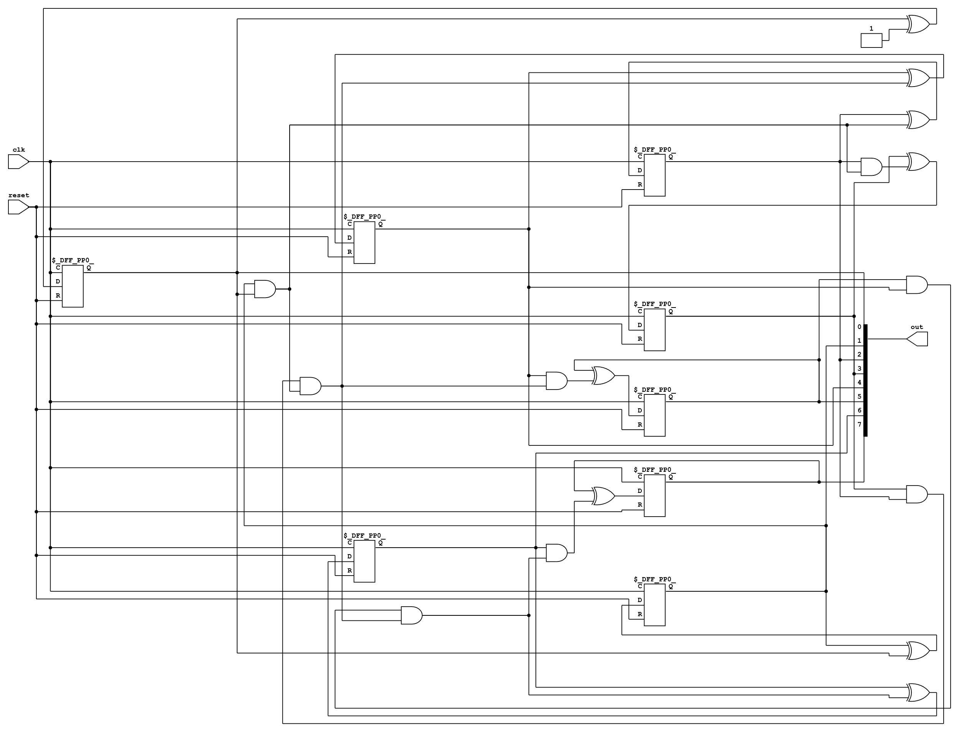
Esempio contatore: sintesi (gates)
$ netlistsvg counter.js -o counter.svg
$ ristretto counter.svg

